Slide 1

7-1 Final Project

Slide 2
Explaining Agile Roles
Product Owner:
Responsible for maximizing the value of the product
Manages the Product Backlog
Ensures the Backlog clearly shows work to be done
Scrum Master:
Responsible for ensuring the Scrum is understood by all
Helps to ensure that the Scrum Team understands the Product Backlog
Facilitates and coaches the Scrum Team through the Scrum Events
Team:
The Team consists of those who work on the deliverable product
Must be self-organized to achieve the goals of the Product Backlog
Development Teams are cross-functional
All members of the Team should have the skills to product increment

Slide 3
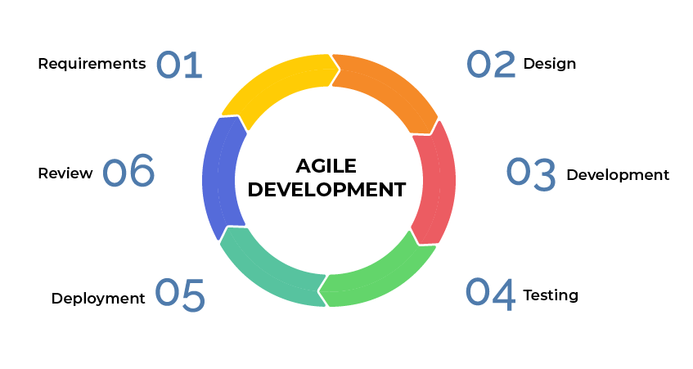
Explaining Agile Phases
Requirements
Product Owners works with Stakeholders to capture project requirements.
Design
This phase is where the requirements are broken down and then become the Product Backlog.
Development
This phase is repeated as needed to complete through a series of Sprints to work through the backlog.
Testing
This phase is to ensure that the product works as intended. Testing can happen during the Development Phase.
Deployment
During this phase the product becomes live to End Users. Any bugs found can be fixed during this stage.
Review
This phase consists of demonstration of the product and receiving feedback from the Stakeholders.

Slide 4
Describing Waterfall Model
Waterfall Method is plan-driven.
Definitions and Documentation is completed prior to starting the project.
Once a phase is completed the next phase is started with no review.

Slide 5
Waterfall vs. Agile Approach
Agile Approach
Waterfall
Continuous Cycles
Planning-Executing-Evaluating
The Stakeholders can see progress at the end of each Sprint
Each Sprint is usually 1-4 Weeks
Focused more on progress over comprehensive documentation
Structured to be Linear
Requirements-Analysis-Design-Coding-Testing-Operations
The Customer only sees the product at the end of the project
Heavily documented, but no review or reiteration

Slide 6

References
Charles G. Cobb. (2015). The Project Manager’s Guide to Mastering Agile : Principles and Practices for an Adaptive Approach. Wiley.

